Slide 1
Predicting Racial Bias Tendencies in Police Stops
Team(0) - Mahir Bathija, Taylor Merry, Hyewon Kim, Christopher Painton

Slide 2
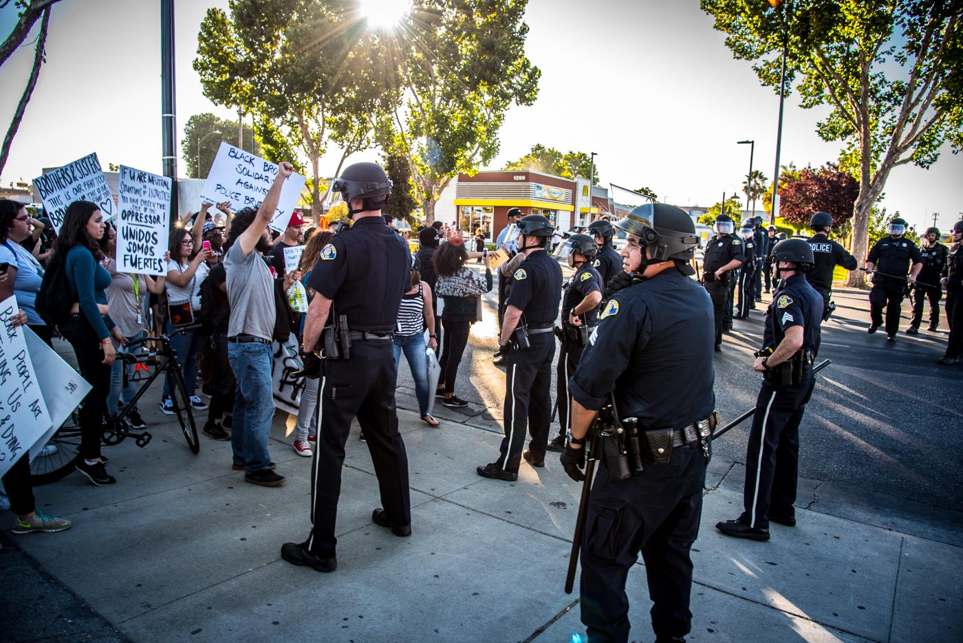
Motivation
We wanted to research the belief that police forces within the United States have adopted policies of discriminatory behavior
These racial injustice claims are highly relevant in our current society
Investigate police practices within our own home state of Washington
Our hope is that we can provide some clarity into an ongoing and evolving issues

Slide 3
Previous Work
Stanford Open Policing Project (Our Primary Data Source)
After stops, officers are more like to ticket, search, and arrest black and Hispanics over white drivers
Are Traffic Stops Prone to Racial Bias
Explains Stanford Open Policing Project data collection strategies Washington State Patrol collect and interprets their data internally twice a year to fight racial discrepancy
Fast Threshold Tests for Detecting Discrimination
Stop thresholds for whites are lower than blacks and hispanics
Precinct or Prejudice? Understanding Racial Disparities in New York City’s Stop and Frisk Policy
Lower thresholds to stop minorities compared to whites, despite stimulating situations of whites within these high-crime rate areas

Slide 4
Research Question
Can we predict the race of an offender from a traffic/pedestrian stop given the stop reasoning along with county information, demographics, and voting history?

Slide 5
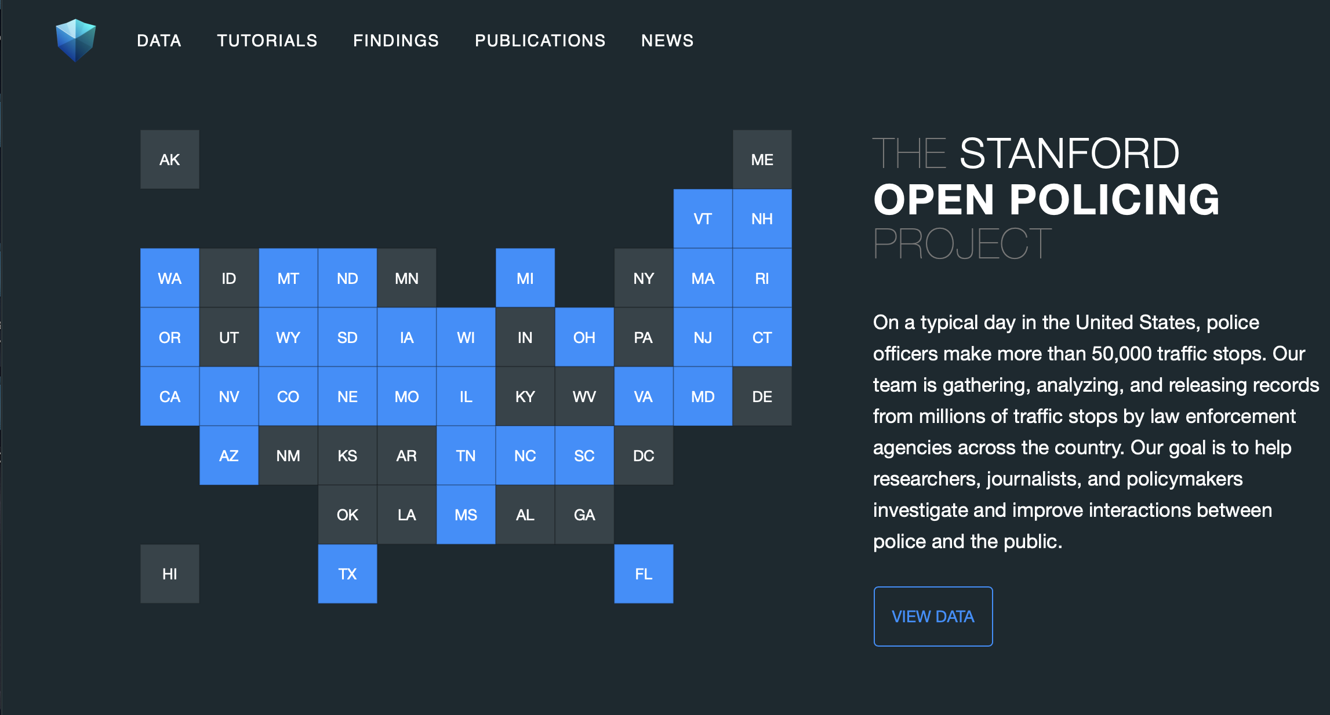
Data Sources
Stanford Open Policing Project
Provides traffic stop data for 31 states containing over 130 million traffic stop records.
Dedicated to the goal “to help researchers, journalists, and policymakers investigate and improve interactions between police and the public”

Slide 6
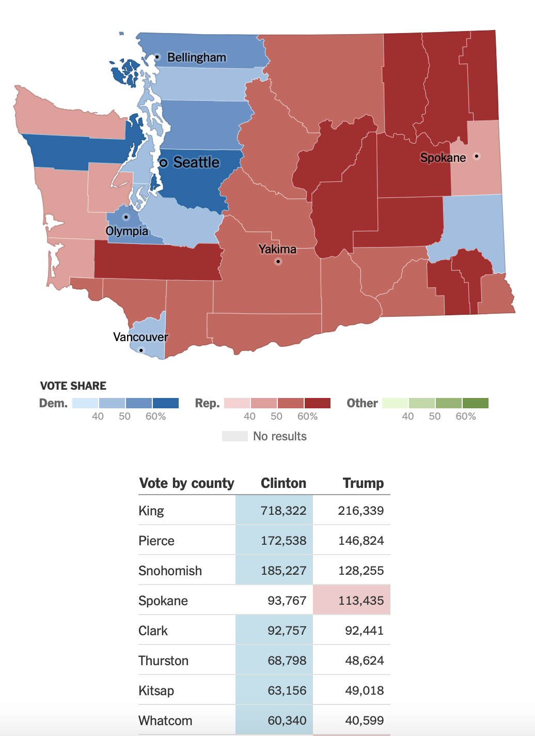
Data Sources
Presidential Election Voting History
From the Secretary of State for Washington website
Provides csv files for 2008, 2012, and 2016 presidential elections by county and candidate
Used 2008 election data for stops within 2009-2010
Used 2012 election data for stops within 2011-2014
Used 2016 election data for stops within 2015-2016

Slide 7
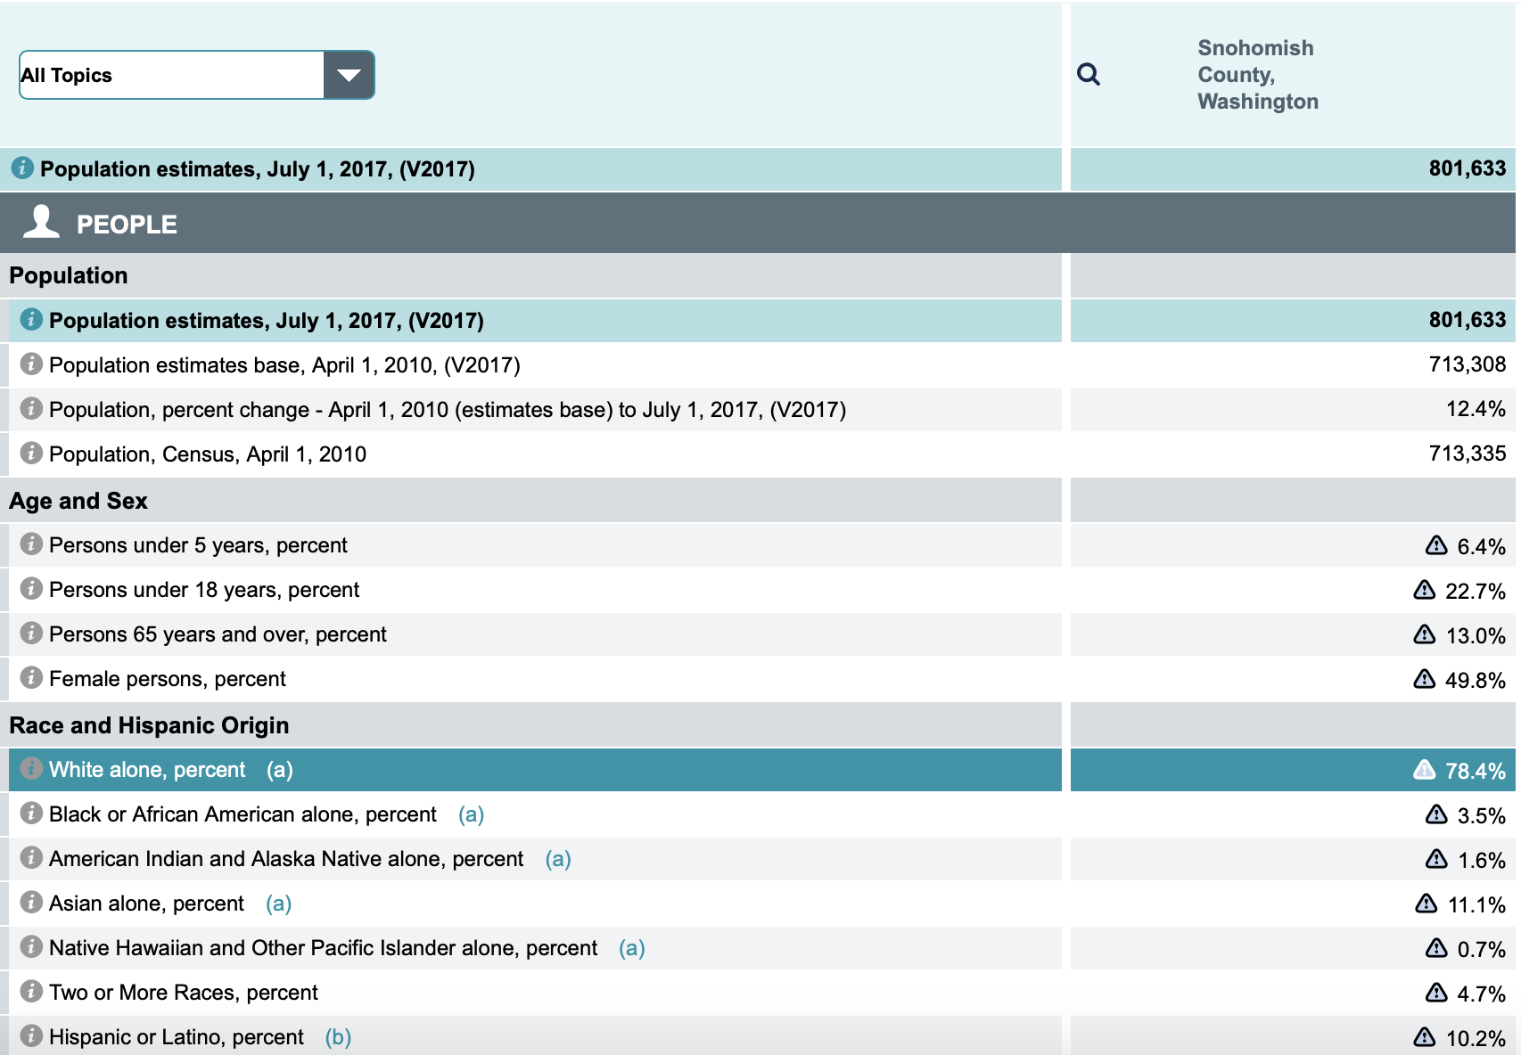
Data Sources
U.S Census Quick Facts (County Demographics)
Provides information on a national, statewide, and county-wide level.
Scraped data from each URL into csv file
This file contains the county name, population of county, race, and the percentage breakdown of the races made up from that county.

Slide 8
Data Analysis Process
We tested each of our predictor variables to see their effects on driver race:
For numerical variables, we used analysis of variance (ANOVA) to determine if the means for each race were statistically different, and then we used Tukey tests to determine which races had different means and by how much.
For categorical variables, we used contingency tables and chi square independence tests to test whether or not each categorical predictor was independent of driver race.
Lastly, we fit an XGBoost model to predict if the driver was a minority based on all of the predictor variables.

Slide 9
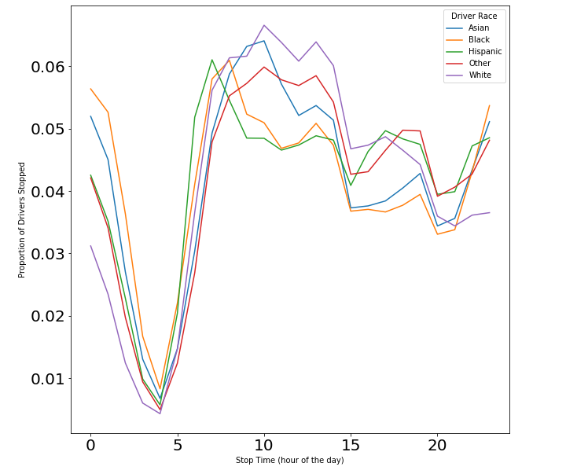
Results (EDA)
Proportions of Drivers Stopped During Stop Times
10AM to 8PM - White drivers stopped more than all other races.
8PM to 4AM - All other races are stopped significantly more than white drivers.
Black drivers are stopped almost twice as often during this period.

Slide 10
Results (EDA)
Searches are conducted on white offenders with a rate of ~2.4%
Searches conducted on black offenders at a rate of ~5.2% and Hispanics at a rate of ~4.1%.
Race | Search Conducted | Search Not Conducted | Percentage of Stops with Search
Asian | 6,838 | 333,620 | 2.0084 %
Black | 12,840 | 235,789 | 5.1643 %
Hispanic | 18,970 | 446,694 | 4.0738 %
White | 97,471 | 4,007,539 | 2.3744 %
Other | 4,346 | 72,799 | 5.6335 %
Race Breakdown of Searches Conducted

Slide 11
Results (ANOVA)
Race 1 vs Race 2 | Difference of Means
Hispanic vs Asian | 0.375
Hispanic vs Black | 0.362
Hispanic vs Other | 0.227
Hispanic vs White | 0.151
Hispanics, on average, were being pulled over in more Republican counties than any other race (republican to democrat ratio of over .15 higher than any other race).
Tukey Test Table for Republican
to Democrat Voting Ratio
Notes:
Taylor

Slide 12
Results (ANOVA)
Race 1 vs Race 2 | Difference of Means
Asian vs Hispanic | 3.901
White vs Asian | 2.272
Black vs Hispanic | 1.989
White vs Black | 4.185
Other vs Hispanic | 2.992
White vs Hispanic | 6.173
White vs Other | 3.181
Hispanic drivers were almost 2 years younger than every other race on average.
White drivers were 2 years older than drivers of any other race.
Tukey Test Table for Driver Age
Notes:
Taylor

Slide 13
Results (Chi2 Independence Test)
All chi squared independence tests came up with low p-values, indicating categorical variables are not independent of one another
Comparison between expected and observed counts for arrests or citations
Whites only race that had their counts decrease from expected to observed.
 | Arrest/Citation Expected | Arrest/Citation Observed | Percentage Change
Asian | 176,229.54 | 198,652 | + 12.72 %
Black | 128,696.56 | 139,903 | + 8.70 %
Hispanic | 241,039.29 | 249,637 | + 3.57 %
Other | 39,932.17 | 46,152 | + 15.58 %
White | 2,124,855.43 | 2,076,409 | - 2.33 %
Expected vs Observed Counts for Arrests/Citations

Slide 14
Results (Chi2 Independence Test)
Displays the violations the had greater than a 25 percent increase of expected violations count to observed violations count
Whites were the only racial group to not have a large increase from expected to observed counts for violations
For transparency, it is worth noting that there was a higher total count for whites
Race | Violation (Percentage Increase from Expected to Observed)
Asian | Moving (45.63%)
Black | DUI (63.43%), License (179.87%), Lights (35.7%), Moving (116.84%)
Hispanic | DUI (51.61%), License (59.26%), Paperwork (34.63%), Stopping (26.12%), Truck (27.90%)
Other | DUI (81.65%), License (137.63%)
White
Violations with Percentage Increase from Expected to Observed

Slide 15
XGBoost Model
XGBoost is a gradient boosting framework. Gradient boosting is an ensemble method. Ensemble methods combine the predictions of several models in order to improve performance.
Boosting is when the model starts with weak learners (simple decision trees) and then iteratively combines them while reducing bias/error to create a strong learner.
Used Binary Classification to predict the Minority Race variable
We chose to prioritize accuracy over implementation time and explainability because we don’t plan on implementing our model to make real time predictions and we aren’t trying to explain our algorithm to non-technical shareholders. Therefore, we chose a model praised for its accuracy and spent a lot of time optimizing the hyperparameters.
Notes:
Taylor

Slide 16
XGBoost Design and Hyperparameters
To adjust for the unbalanced dataset (~80/20 split of whites to minorities), we undersampled the white population for the training set (within KFold loop)
K Fold Cross Validation (k = 5): for scale_pos_weight, learning rate, and n_estimators
For Other Hyperparameter Tuning:
Grid Search (with the Grid Search CV function) to iterate through different parameter combinations and return the best combination (after 3 cv folds) based on the highest mean auroc (receiver operating characteristic)
max depth (maximum depth of a tree) min_child_weight (min sum of weights of all observations) subsample (fraction of observations to be randomly sampled for each tree) colsampe_bytree(fraction of observations to be randomly sampled for each tree) gamma and alpha

Slide 17
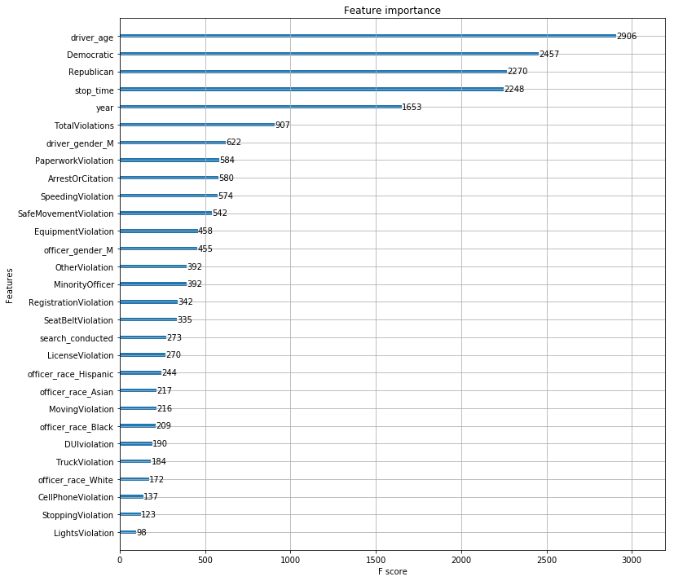
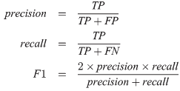
XGBoost Results
Accuracy: 62.89%
F1 Score: 0.442
Notes:
Taylor

Slide 18
Limitations & Future Directions
Shortcomings:
Undersampling issue
Lack of time and resources
Only able to use k=3 k-fold due to the large number of rows
Therefore, even if predicted correct, we still can't attribute it completely to racial bias.
Engineer more features/variables starting with search conducted.
We only scoped one of the 50 states.

Slide 19
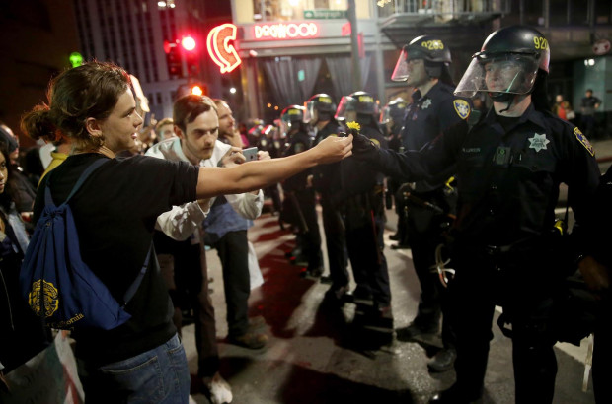
Closing
Although model was unsuccessful, perhaps it is good that we couldn’t predict the driver race
Massive issue that continues to grow and so will the data
We hope that our research, although on a smaller scale, will motivate others and add valuable information to this ongoing topic

Slide 20
Questions?

